Slide 1
Lambda Authorizer Auth WorkFlow.
Validacion de usuarios que entran(url) a algunos servicios.
https://docs.aws.amazon.com/apigateway/latest/developerguide/apigateway-use-lambda-authorizer.html
¿Qué es OAuth?
¿Qué es SAML?
¿Qué es token web json – JWT?
https://www.youtube.com/watch?v=V7BLIXRyhG8

Slide 2
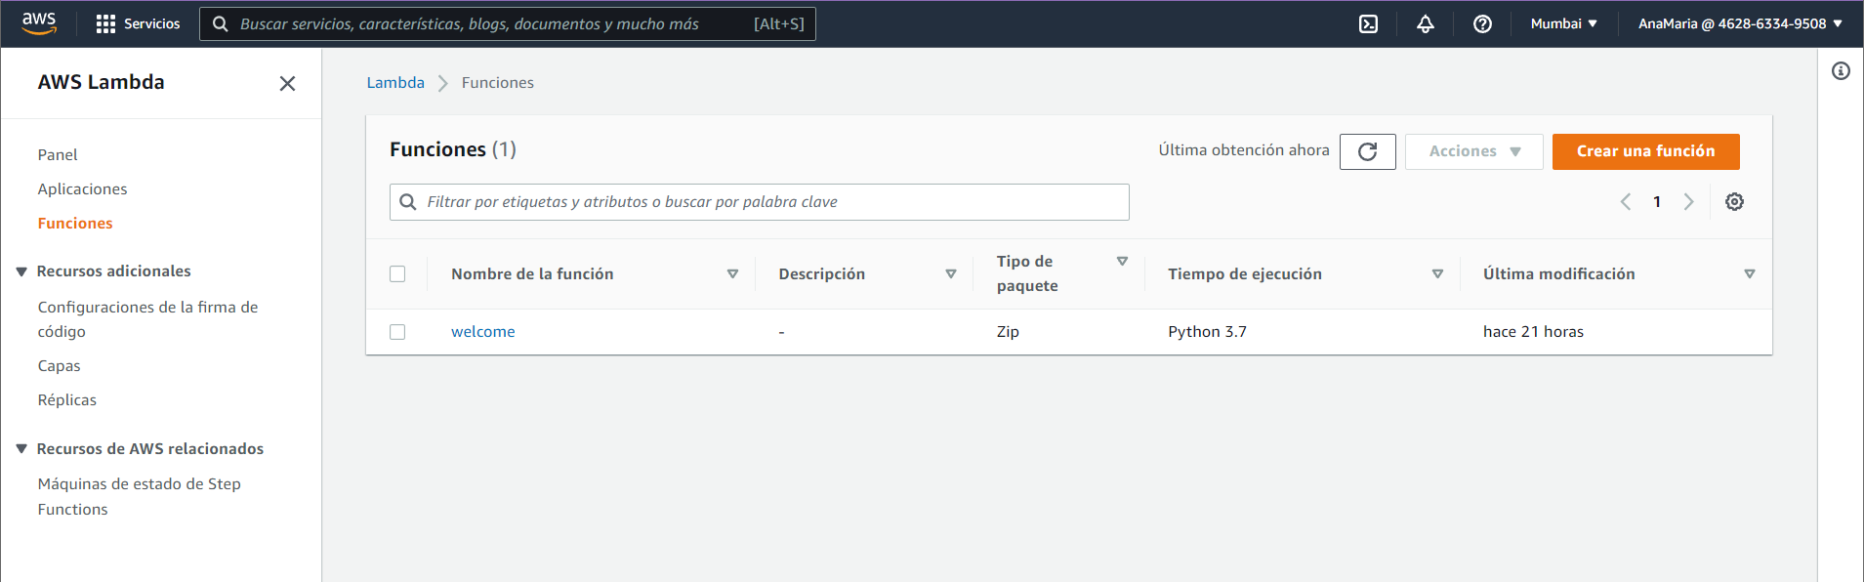

Slide 3
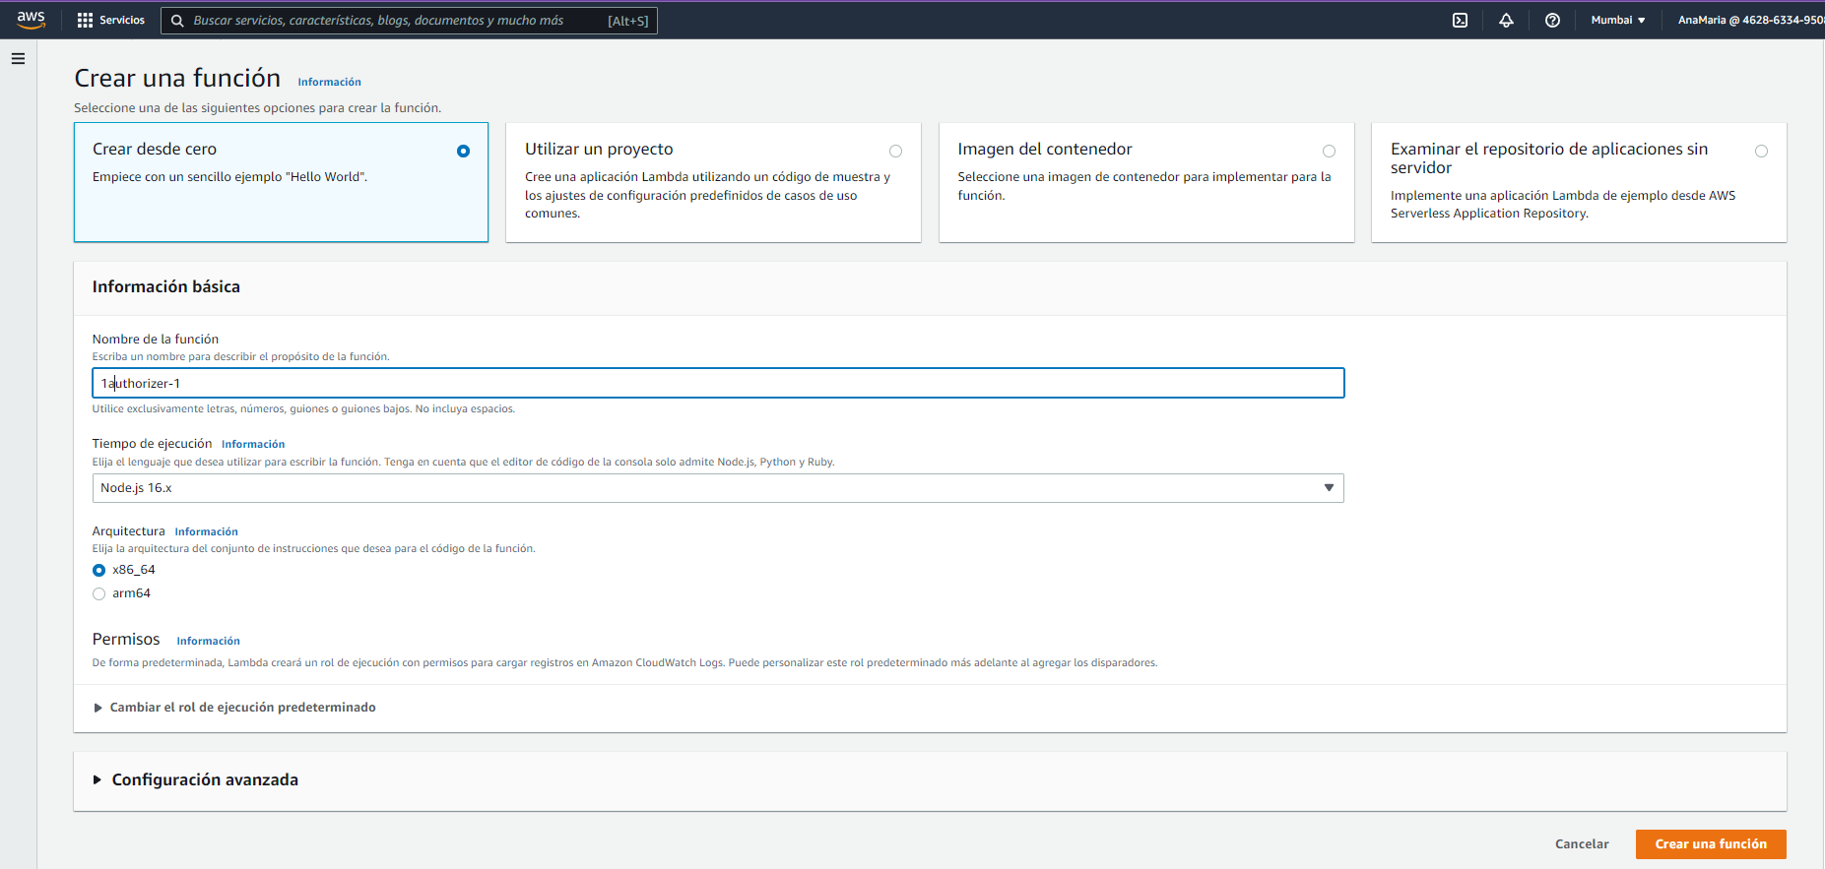

Slide 4
// A simple token-based authorizer example to demonstrate how to use an authorization token
// to allow or deny a request. In this example, the caller named 'user' is allowed to invoke
// a request if the client-supplied token value is 'allow'. The caller is not allowed to invoke
// the request if the token value is 'deny'. If the token value is 'unauthorized' or an empty
// string, the authorizer function returns an HTTP 401 status code. For any other token value,
// the authorizer returns an HTTP 500 status code.
// Note that token values are case-sensitive.
exports.handler = function(event, context, callback) {
var token = event.authorizationToken;
switch (token) {
case 'allow':
callback(null, generatePolicy('user', 'Allow', event.methodArn));
break;
case 'deny':
callback(null, generatePolicy('user', 'Deny', event.methodArn));
break;
case 'unauthorized':
callback("Unauthorized"); // Return a 401 Unauthorized response
break;
default:
callback("Error: Invalid token"); // Return a 500 Invalid token response
}
};
// Help function to generate an IAM policy
var generatePolicy = function(principalId, effect, resource) {
var authResponse = {};
authResponse.principalId = principalId;
if (effect && resource) {
var policyDocument = {};
policyDocument.Version = '2012-10-17';
policyDocument.Statement = [];
var statementOne = {};
statementOne.Action = 'execute-api:Invoke';
statementOne.Effect = effect;
statementOne.Resource = resource;
policyDocument.Statement[0] = statementOne;
authResponse.policyDocument = policyDocument;
}
// Optional output with custom properties of the String, Number or Boolean type.
authResponse.context = {
"stringKey": "stringval",
"numberKey": 123,
"booleanKey": true
};
return authResponse;
}

Slide 5
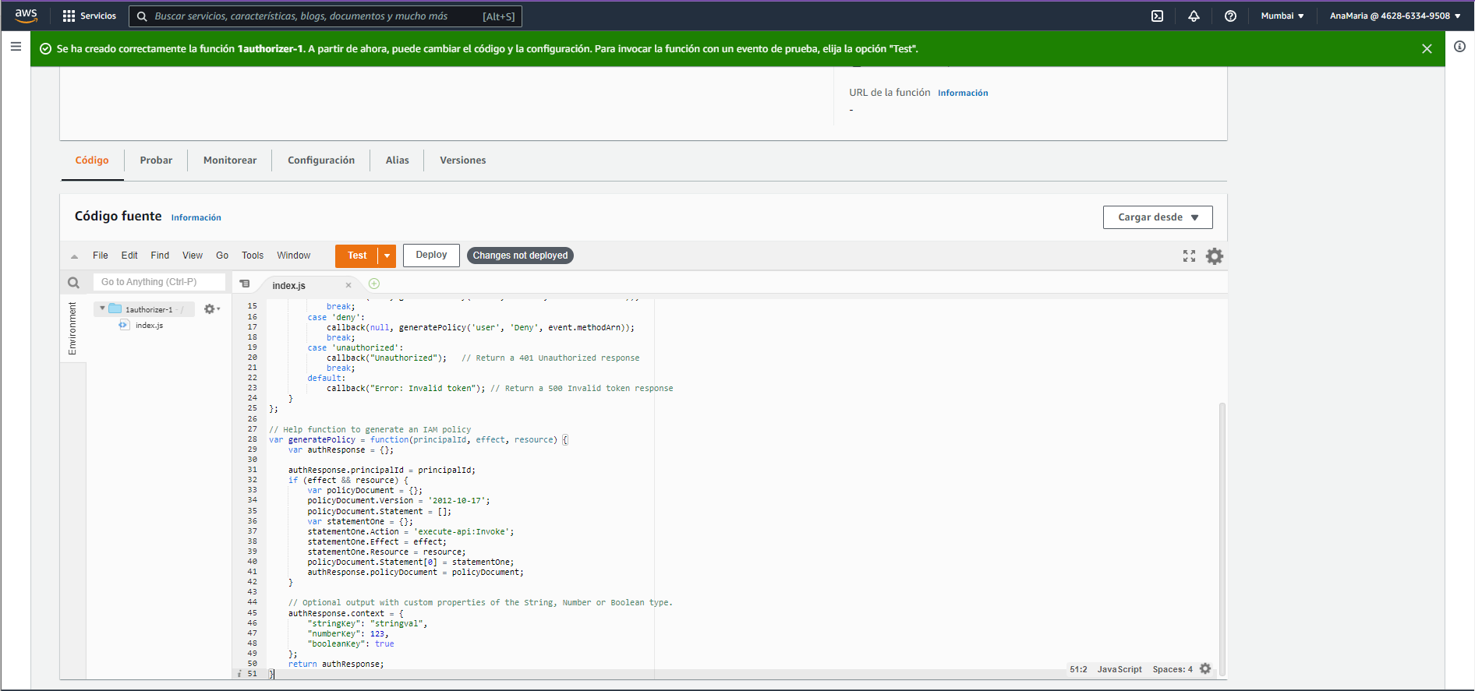

Slide 6
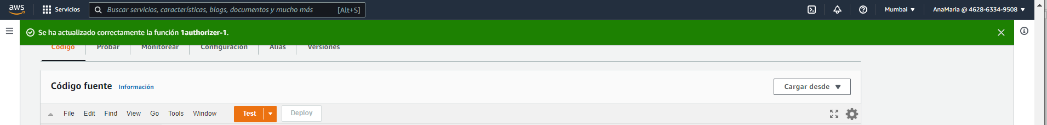

Slide 7
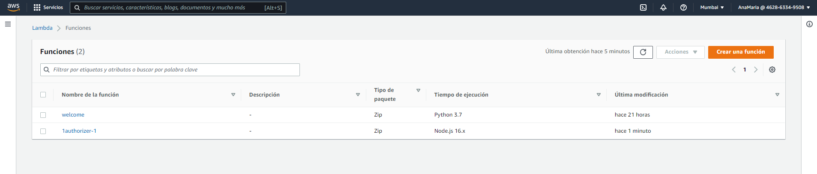

Slide 8
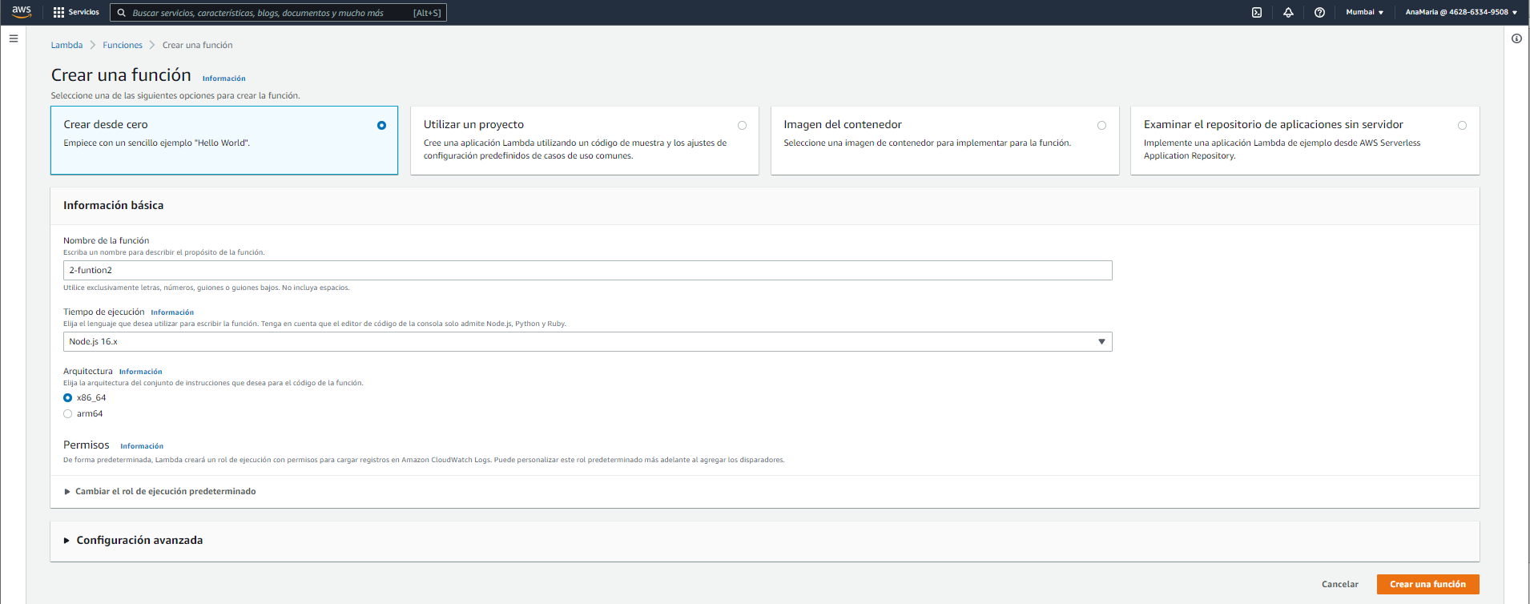

Slide 9
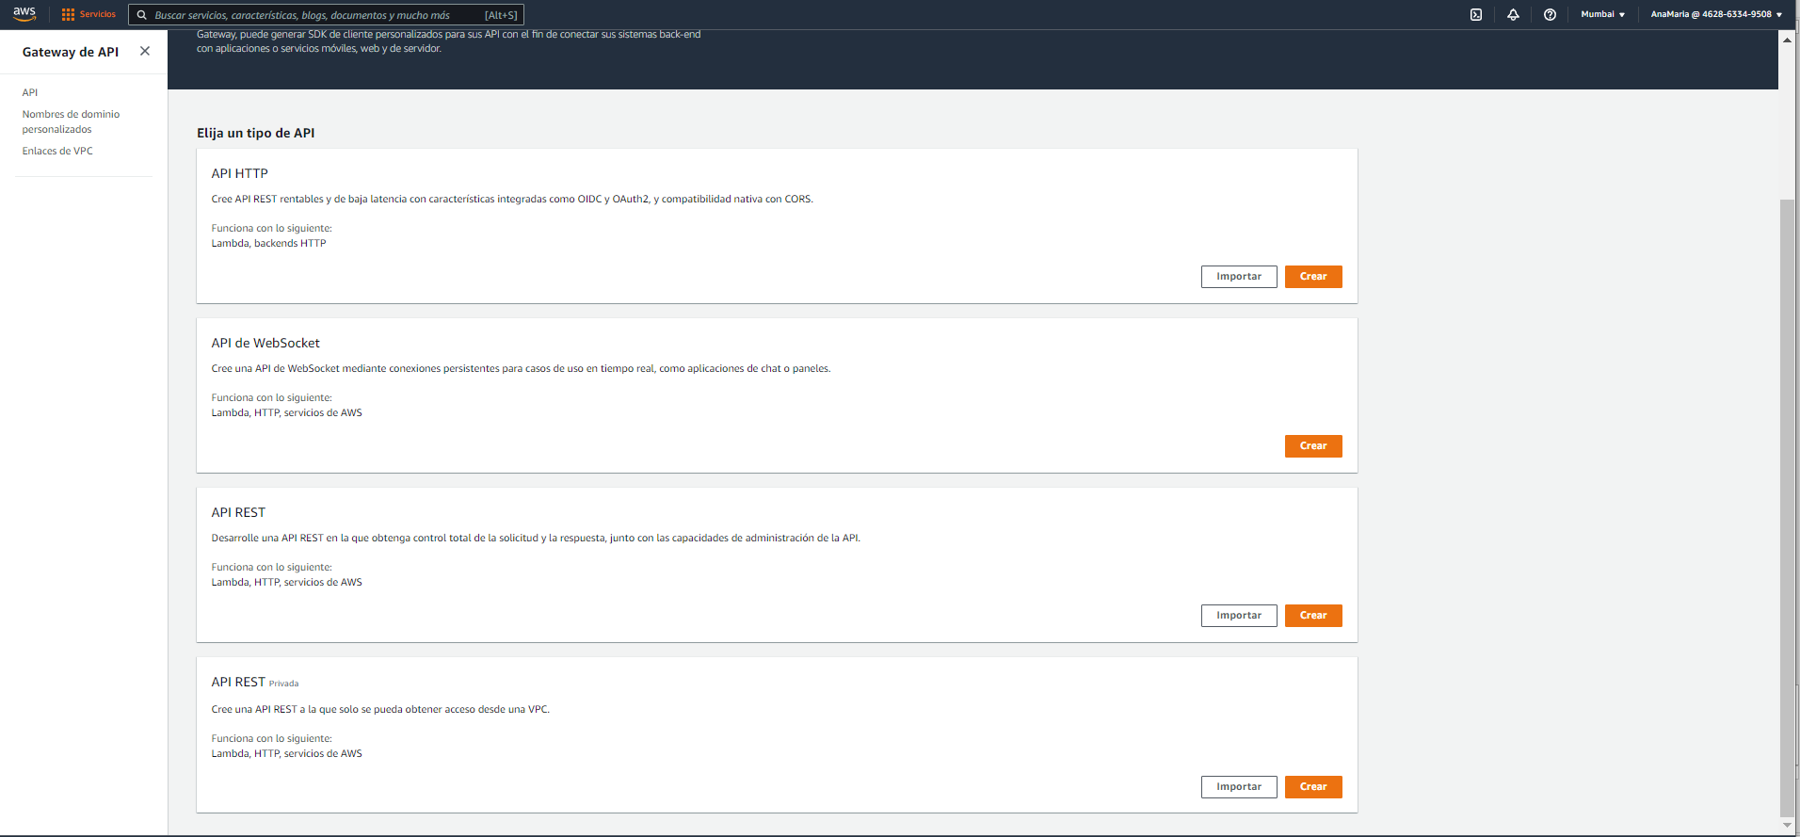
Rest API

Slide 10
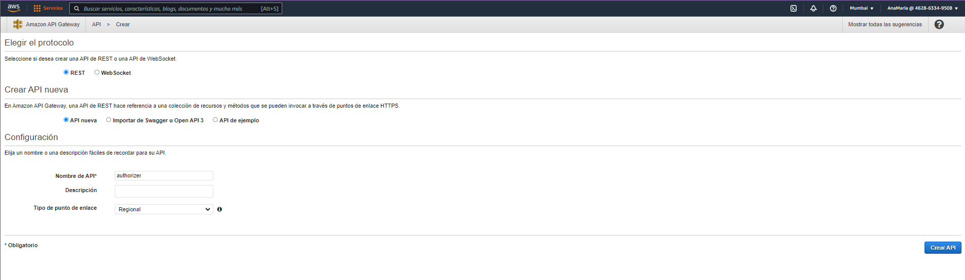

Slide 11
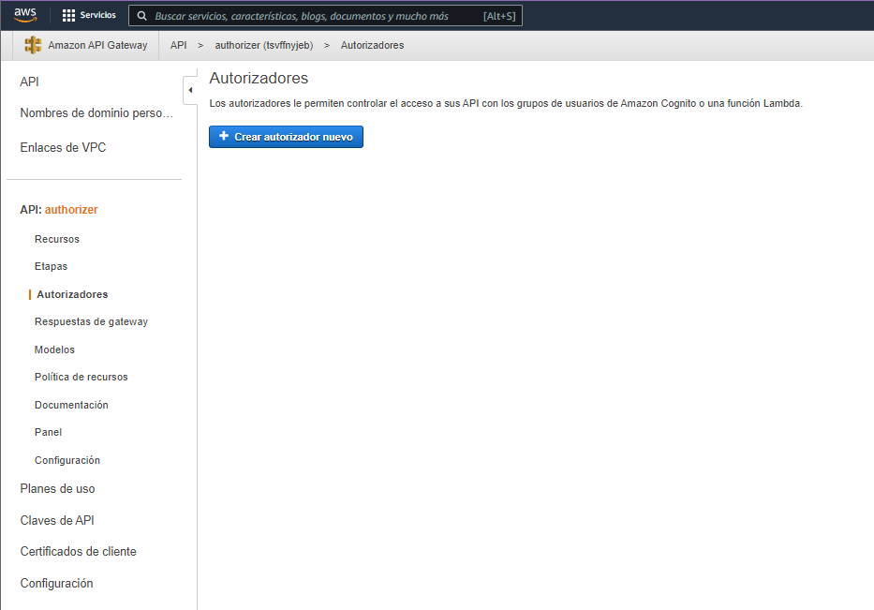

Slide 12
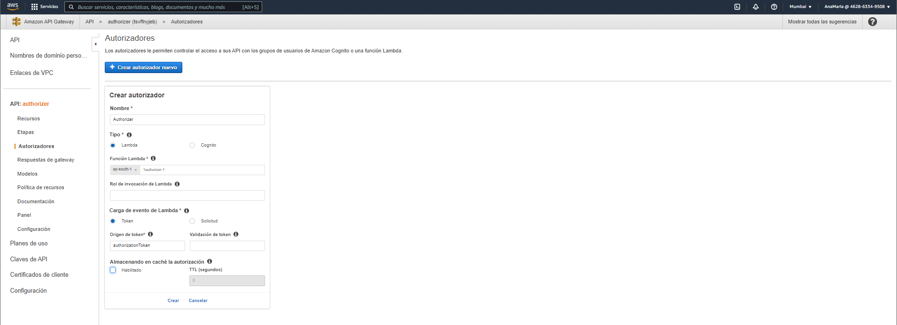

Slide 13
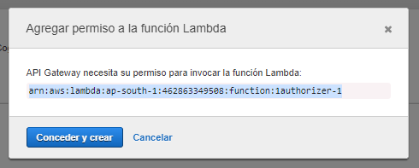

Slide 14
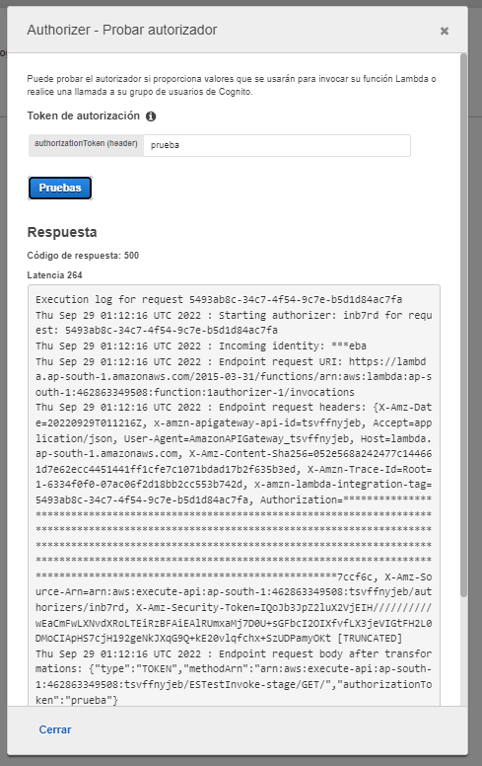

Slide 15
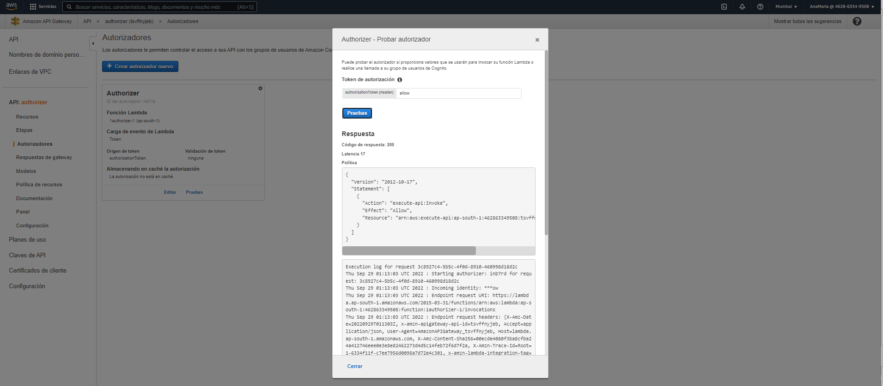

Slide 16
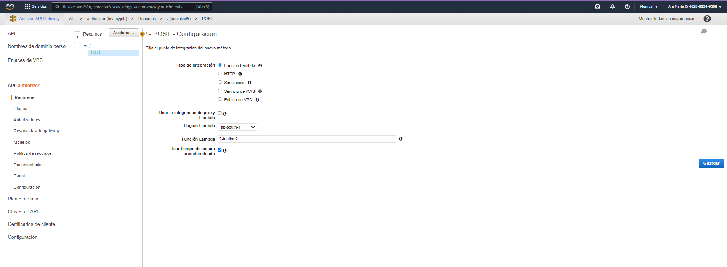

Slide 17
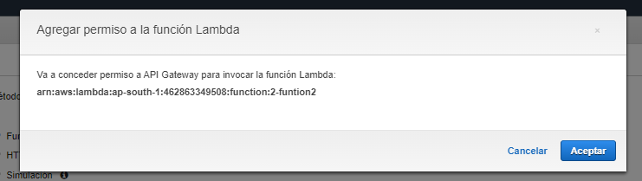

Slide 18
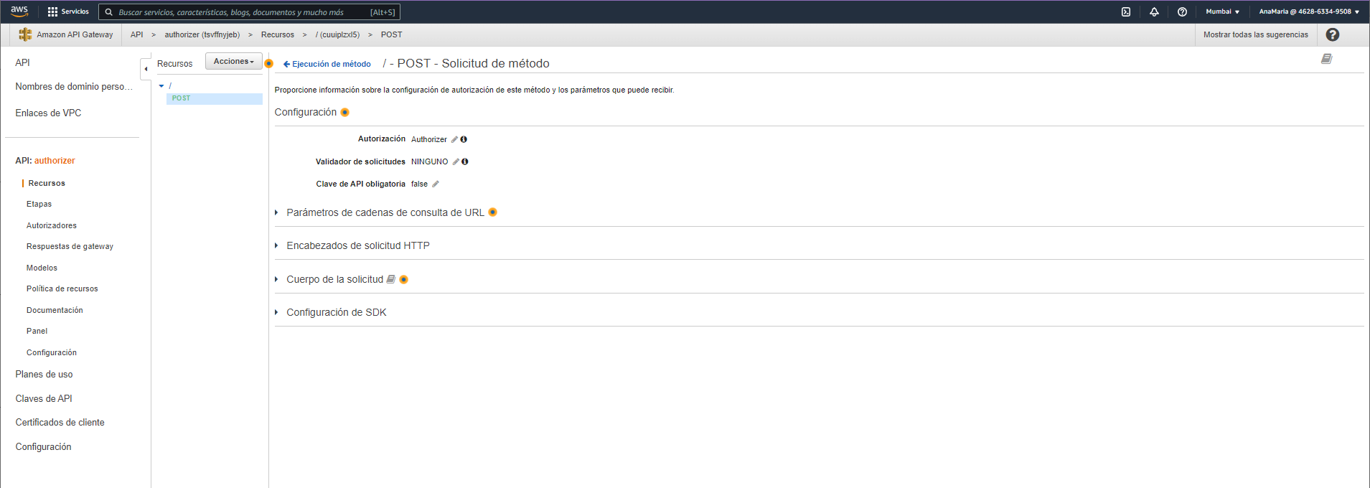

Slide 19
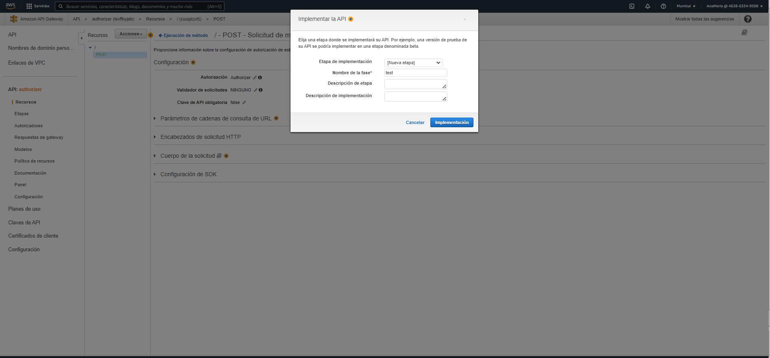

Slide 20
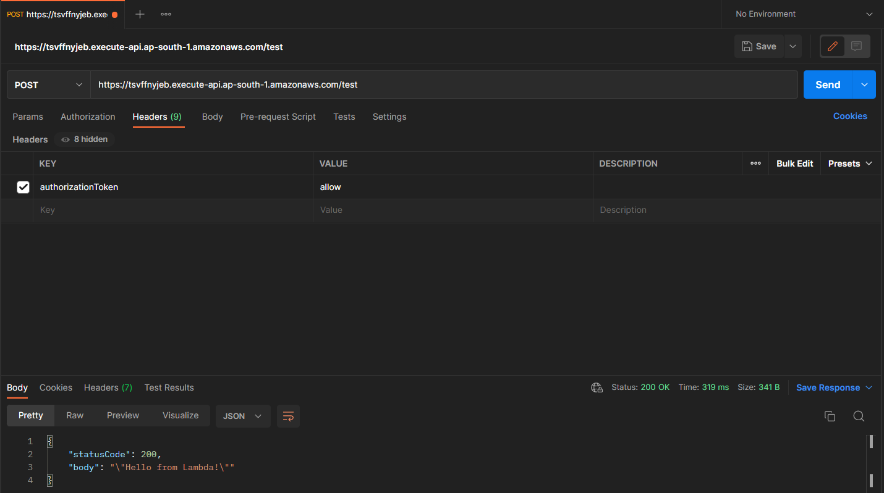

Slide 21
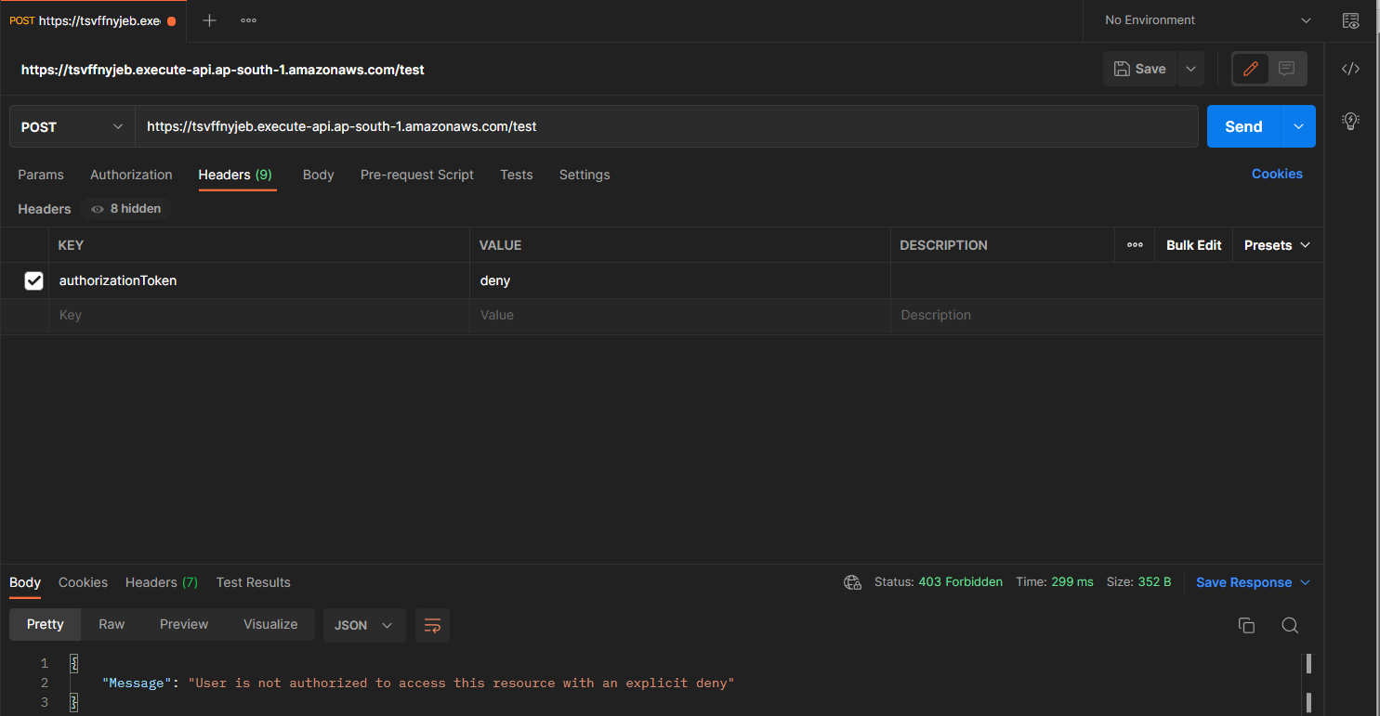

Slide 22
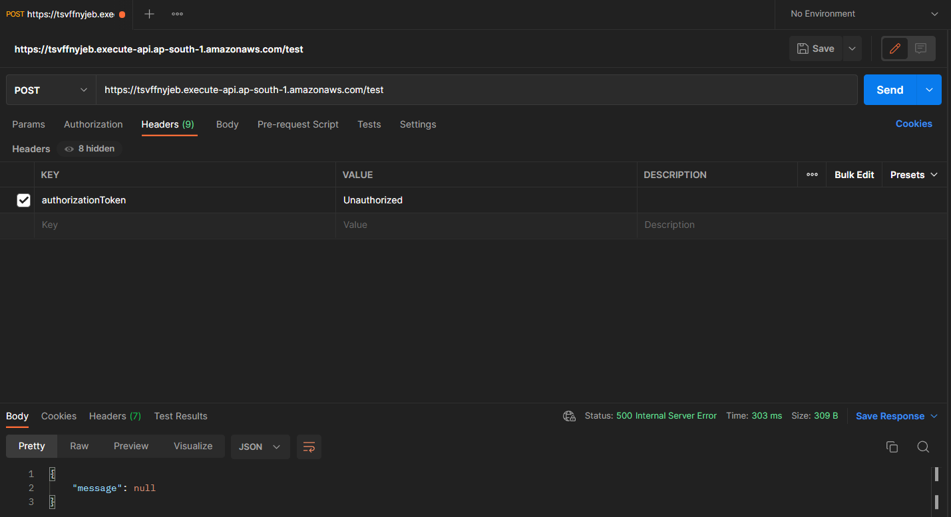

Slide 23
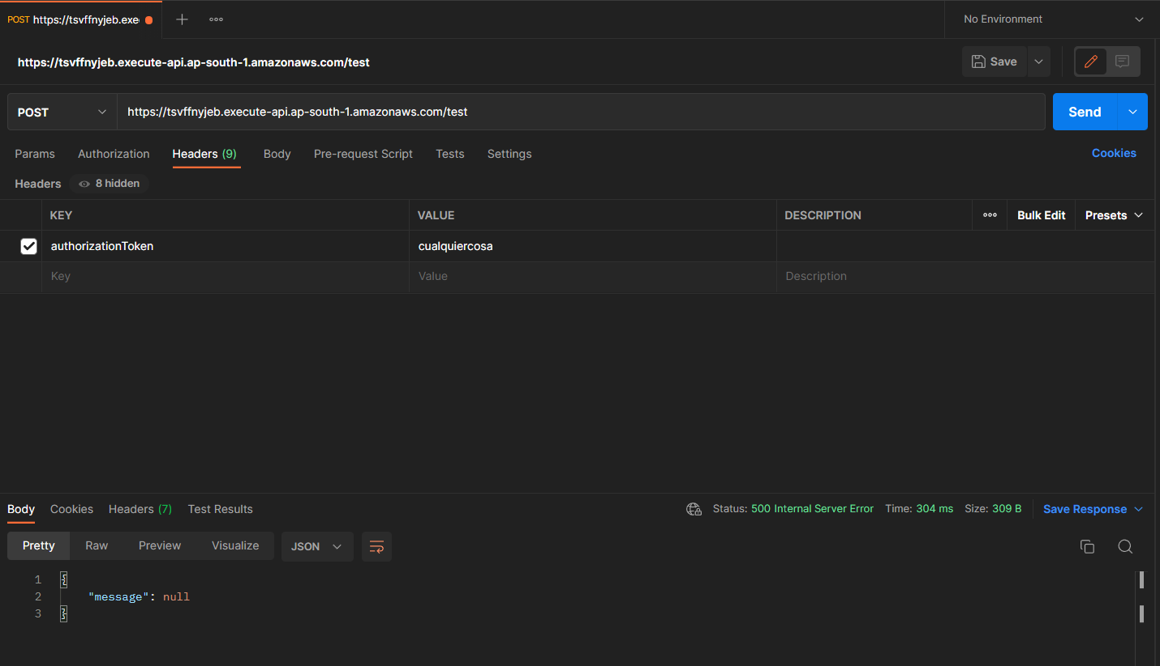

Slide 24
https://www.youtube.com/watch?v=SkbcSbF0uq4

